Slide 1
Text Analysis in Python
Sentiment analysis

Slide 2
Overview
 | Content | Duration
1 | Introduction to text analysis Download lesson materials What is sentiment analysis | 5 min
2 | Demonstration & hands on Data cleaning Exploratory data analysis Sentiment analysis | 80 min
3 | Conclusion Summary Additional resources | 5 min

Slide 3

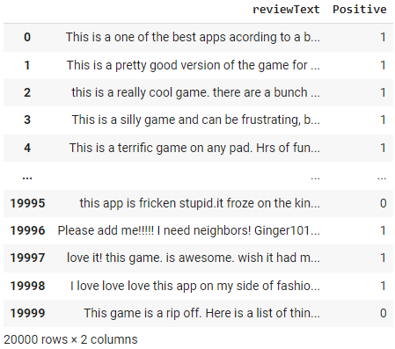

Why text analysis in Python?
“love it! This game is awesome…”
“This is a really cool game…”
“This is a silly game and can be frustrating…”
“This game is a rip off…”

Slide 4
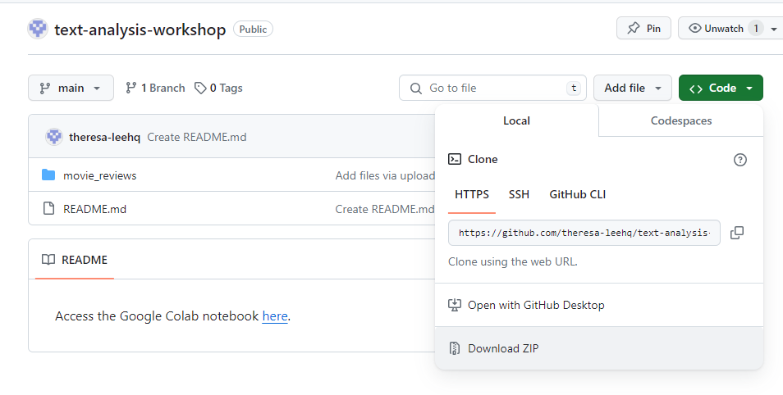
Download lesson materials
Go to https://github.com/theresa-leehq/text-analysis-workshop
Download the movie_reviews folder from GitHub.
Click the green ‘Code’ button
Click ‘Download ZIP’

Slide 5
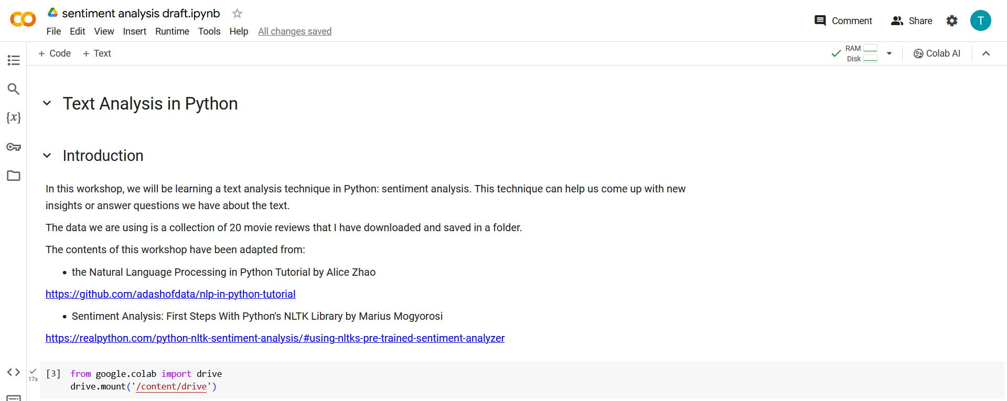
Download lesson materials
Log into your Google account on https://colab.google/.
Save a copy of the lesson notebook and materials with this link:
https://colab.research.google.com/drive/1YiDoenHyNJ5UdZbkE4kXctxfAZkPAQpE?usp=sharing

Slide 6
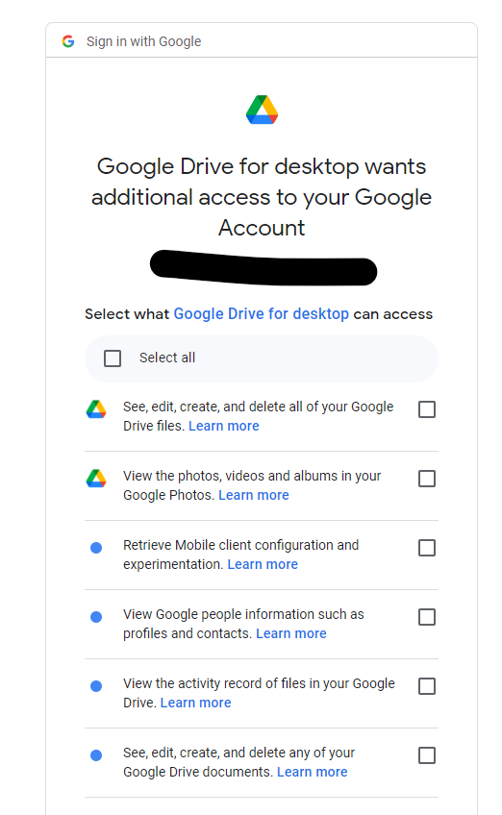

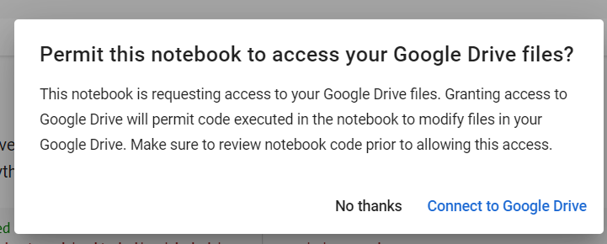
Give Google Colab permission to access Google Drive

Slide 7
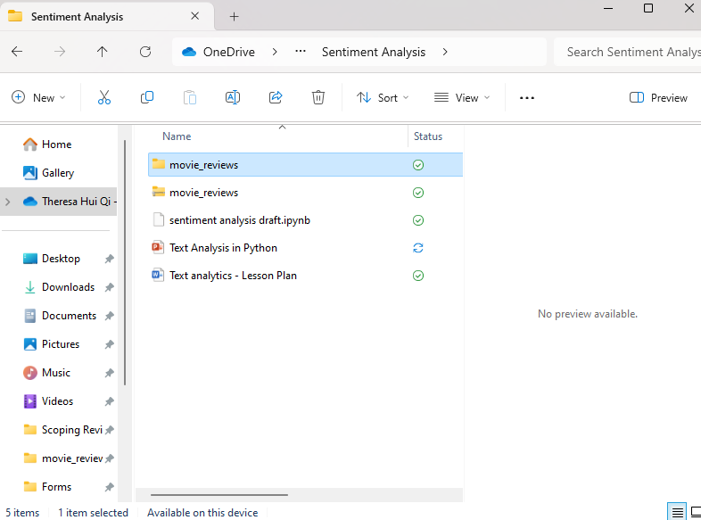
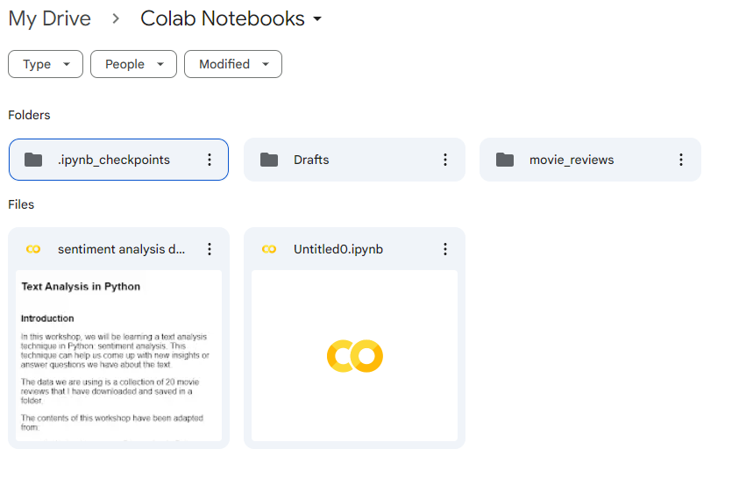
Copy movie_reviews folder into Colab Notebooks folder

Slide 8
Workflow
Get and clean data
Perform exploratory data analysis
Apply techniques
Share insights

Slide 9
Workflow
Get and clean data
Perform exploratory data analysis
Apply techniques
Share insights

Slide 10
Sentiment Analysis
Data – 20 movie reviews downloaded from the internet and saved as .txt files

Slide 11
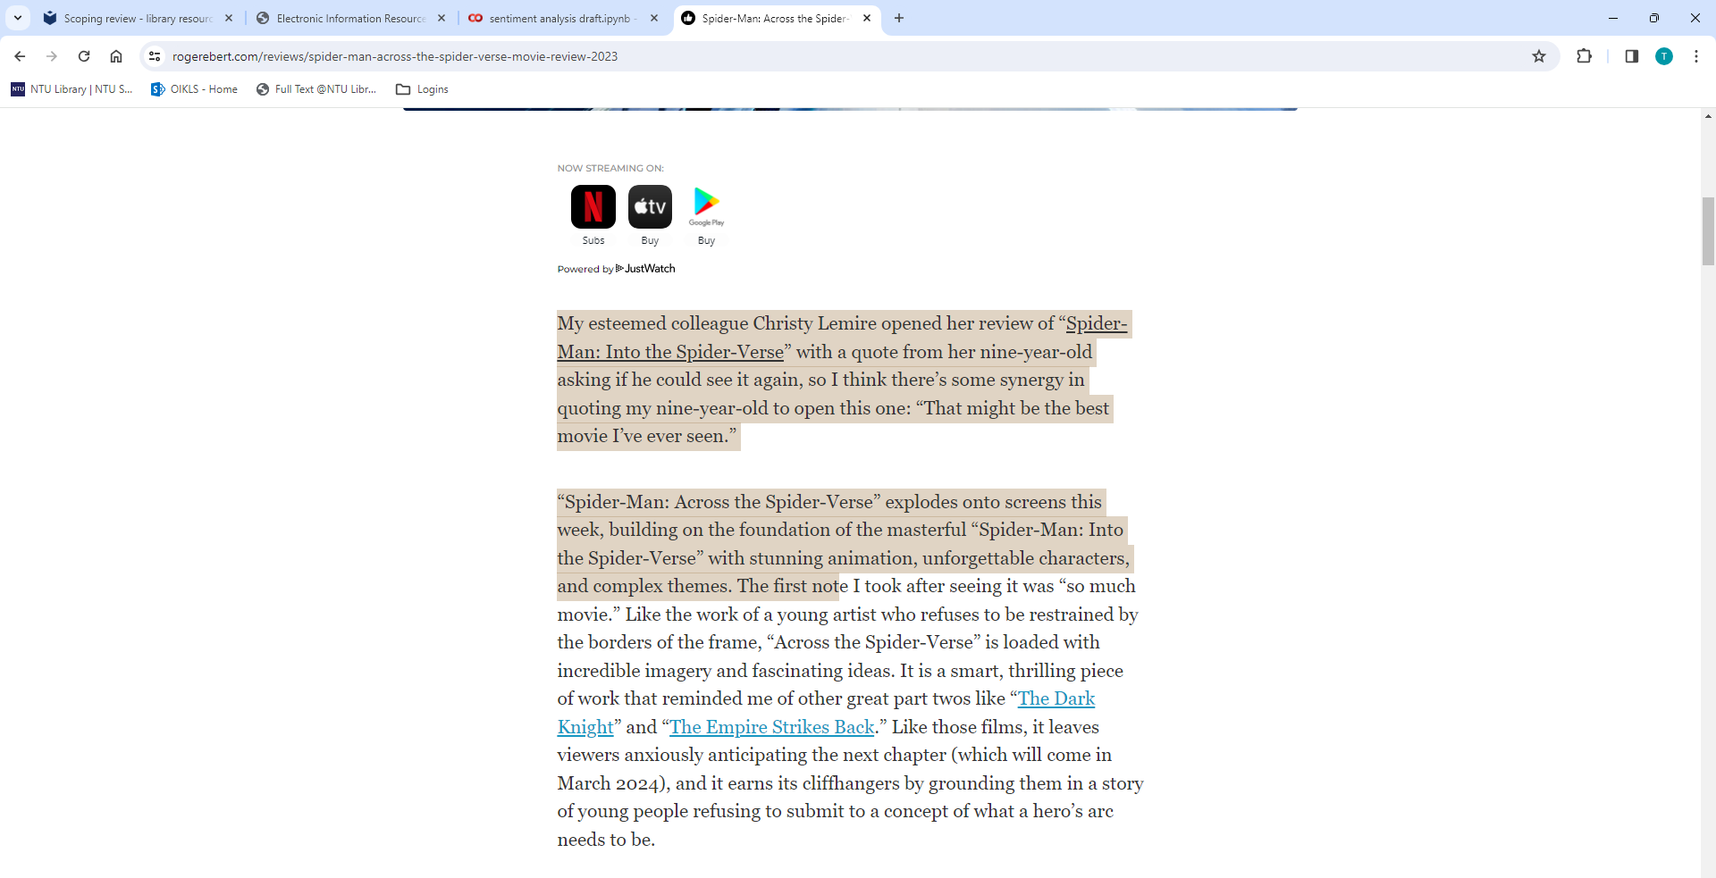
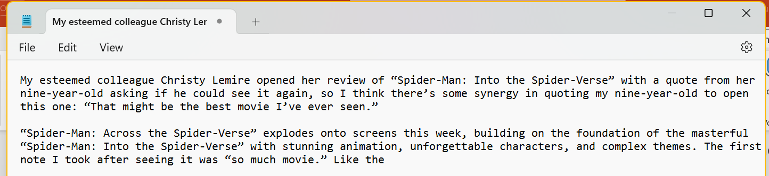

Slide 12
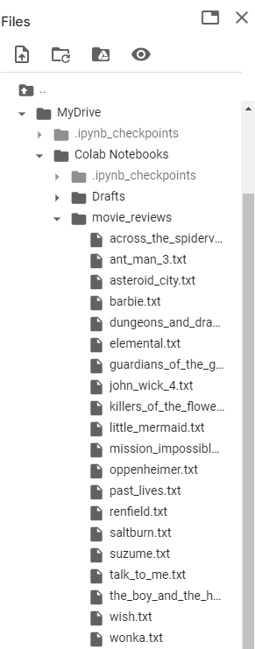
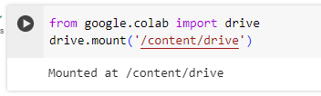

Slide 13
Sentiment Analysis
Open text files and load data into Python
Clean the data
Standardise text and remove irrelevant characters (punctuation, numbers)
Remove stop words (e.g. the, a, it, is)
Lowercase letters
Exploratory data analysis
Find word frequency
Create word clouds
Perform sentiment analysis

Slide 14
Sentiment Analysis
Input: Corpus – a collection of texts
Review name | Text
across_the_spiderverse | esteemed colleague christy lemire opened her review of into the with a quote from her nineyearold asking if he could see it again so i think s...
ant_man_3 | and the wasp quantumania is an atrocious movie but atrocious in a way that marvel movies rarely are up until now the films of the mcu have for t...
asteroid_city | the latest from wes anderson is filled with the assiduous visuals mythic faces and charming curiosities that you expect from this singular filmm...
… | …

Slide 15
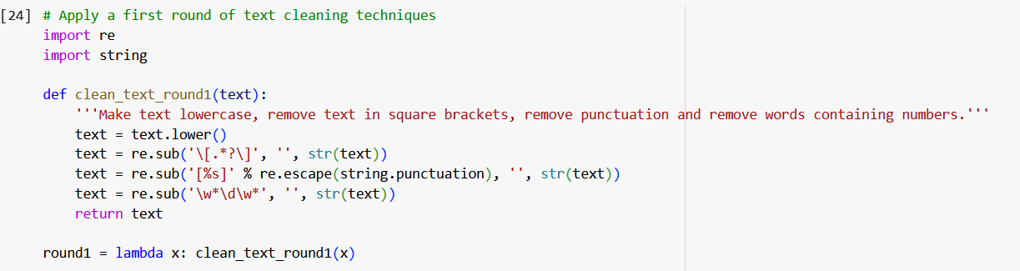
Data Cleaning
My esteemed colleague Christy Lemire opened her review of “Spider-Man: Into the Spider-Verse” with a quote from her nine-year-old asking if he could see it again, so I think there’s some synergy in quoting my nine-year-old to open this one: “That might be the best movie I’ve ever seen.”
my esteemed colleague christy lemire opened her review of spider man into the spider verse with a quote from her nine year old asking if he could see it again so i think there s some synergy in quoting my nine year old to open this one that might be the best movie i ve ever seen
Remove punctuation
Remove numbers
Lowercase letters

Slide 16
Data Cleaning
Tokenization – split text into smaller pieces (i.e. tokens). Most commonly tokens are words or sentences.
my esteemed colleague christy lemire opened her review of spider man into the spider verse with a quote from her nine year old asking if he could see it again so i think there s some synergy in quoting my nine year old to open this one that might be the best movie i ve ever seen
esteemed colleague christy lemire opened review spider man spider verse quote nine year old asking could see i think synergy quoting nine year old open one might best movie ever seen
Remove stop words

Slide 17
Demo

Slide 18
Workflow
Get and clean data
Perform exploratory data analysis
Apply techniques
Positive/negative
Train classifier
Share insights

Slide 19
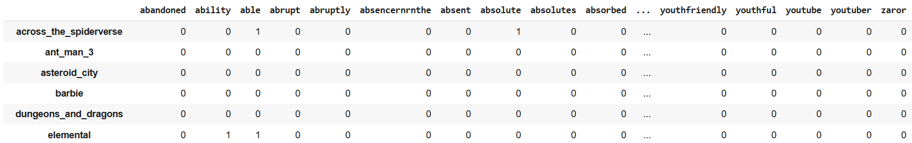
Organise the data
Document-term matrix
Word count of each word in each document

Slide 20
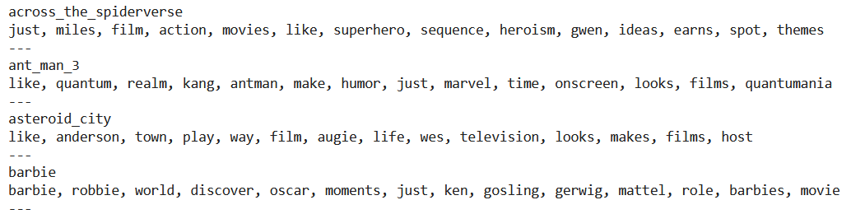
Most common words
Find the most common words said in each review

Slide 21
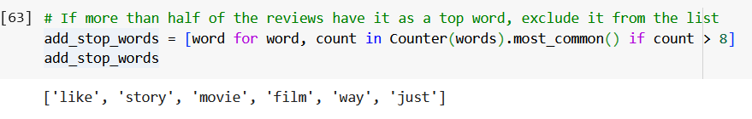
Remove more stop words
Find which common words can be added to stop words

Slide 22
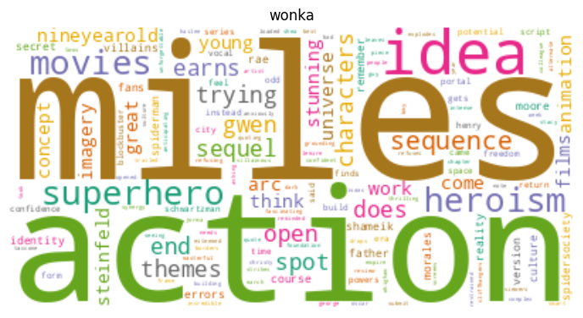
Create word clouds

Slide 23
Demo

Slide 24
Workflow
Get and clean data
Perform exploratory data analysis
Apply techniques
Share insights

Slide 25
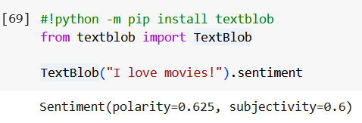

Sentiment Analysis
TextBlob
Sentiment: -1 is negative, +1 is positive, 0 is neutral
Polarity: -1 is objective, +1 is subjective, 0 is neutral

Slide 26
Demo

Slide 27
Workflow
Get and clean data
Perform exploratory data analysis
Apply techniques
Positive/negative
Train classifier
Share insights

Slide 28
Share insights
Which were the worst reviewed films?
Did you expect these films to be reviewed so badly?
Do movie reviews tend to be more subjective or objective?

Slide 29
Analyse new data
Find a new movie review
Pass data through sentiment analyses

Slide 30
Summary
Text pre-processing
Data cleaning, Document-Term Matrix, pandas library, scikit-learn
Exploratory data analysis
Word frequency, word cloud
Sentiment analysis
TextBlob

Slide 31
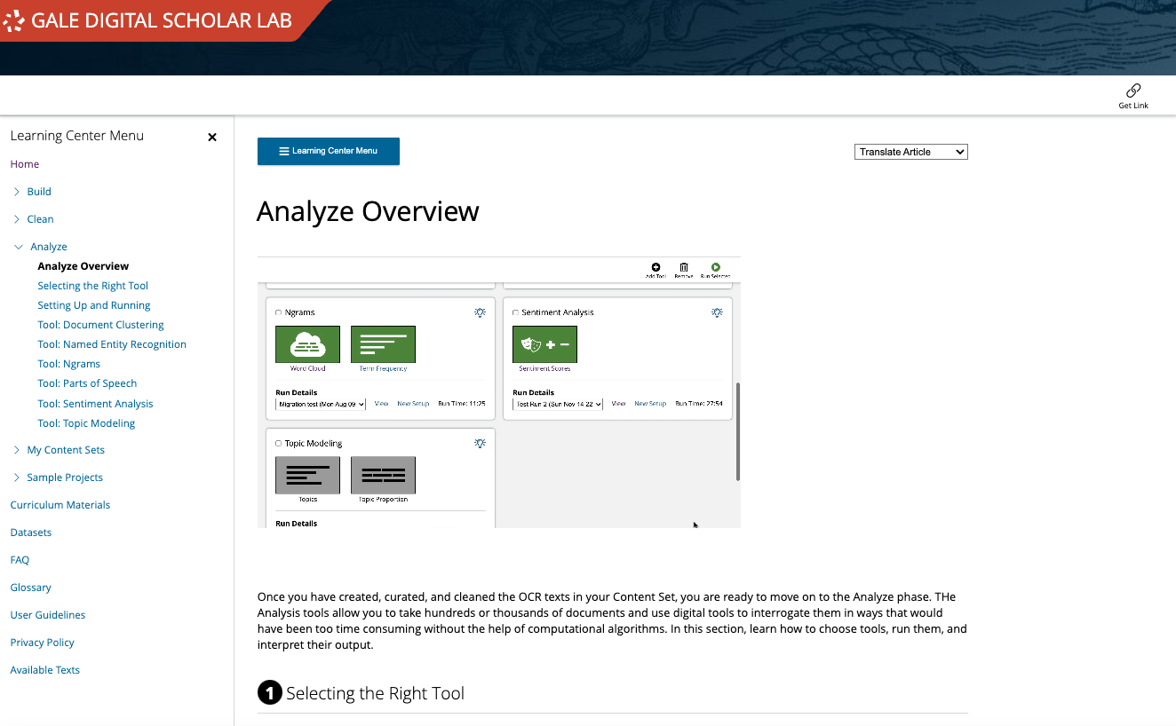
Other text analysis tools
Gale Digital Scholar Lab
Sentiment analysis
Topic modelling
Named entity recognition

Slide 32
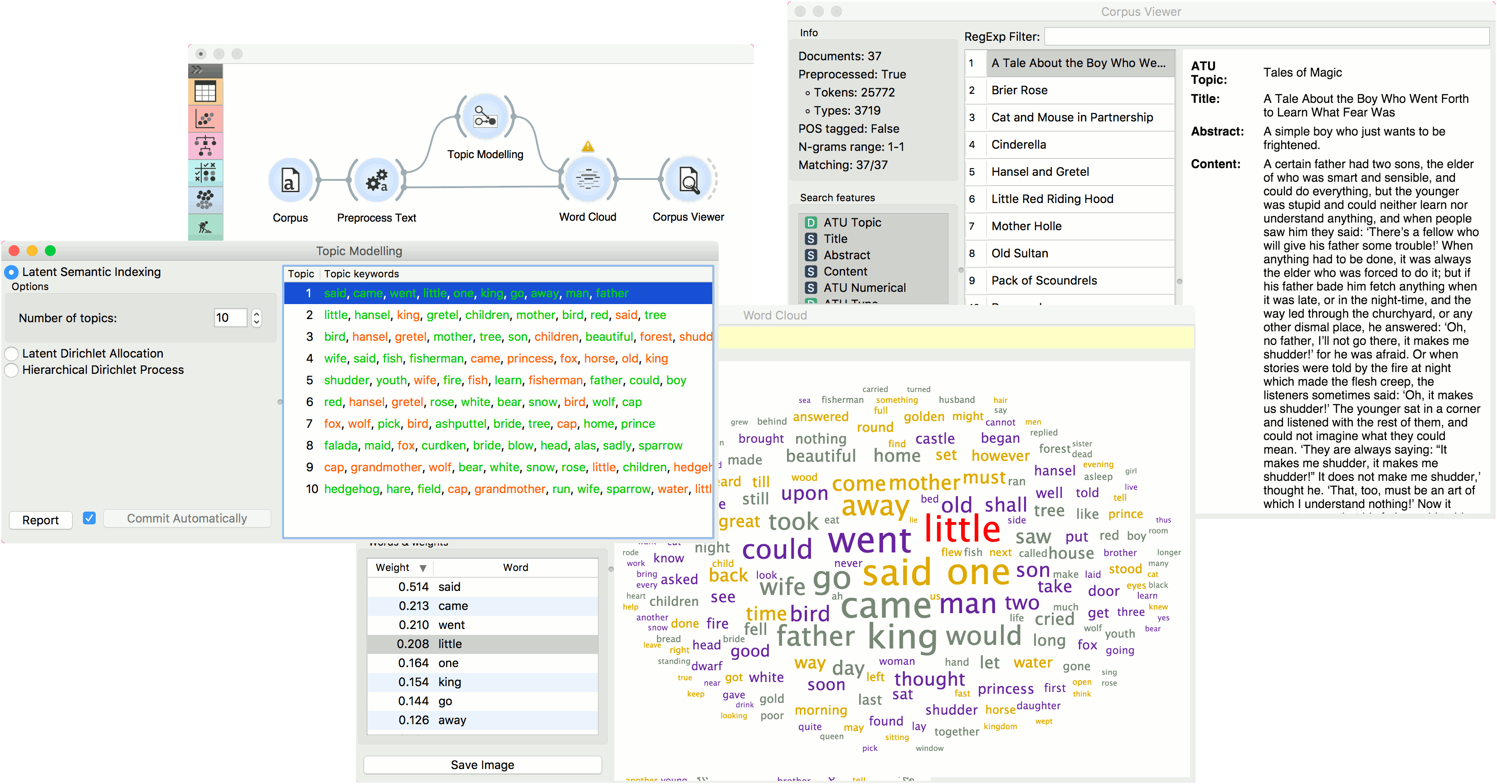
Other text analysis tools
Orange Data Mining
Text mining
Sentiment analysis

Slide 33
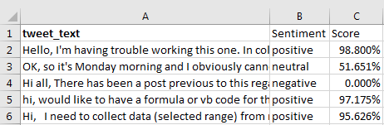
Other text analysis tools
Microsoft Excel
Azure Machine Learning add-in

